Slide 1


SOCIAL NETWORK ANALYSIS PROJECT

Slide 2
Team Members
Akshat Jain 205123010
Hari Mohan 205123038
Rahul Kumar Sah 205123080
Rahul 205123078

Slide 3
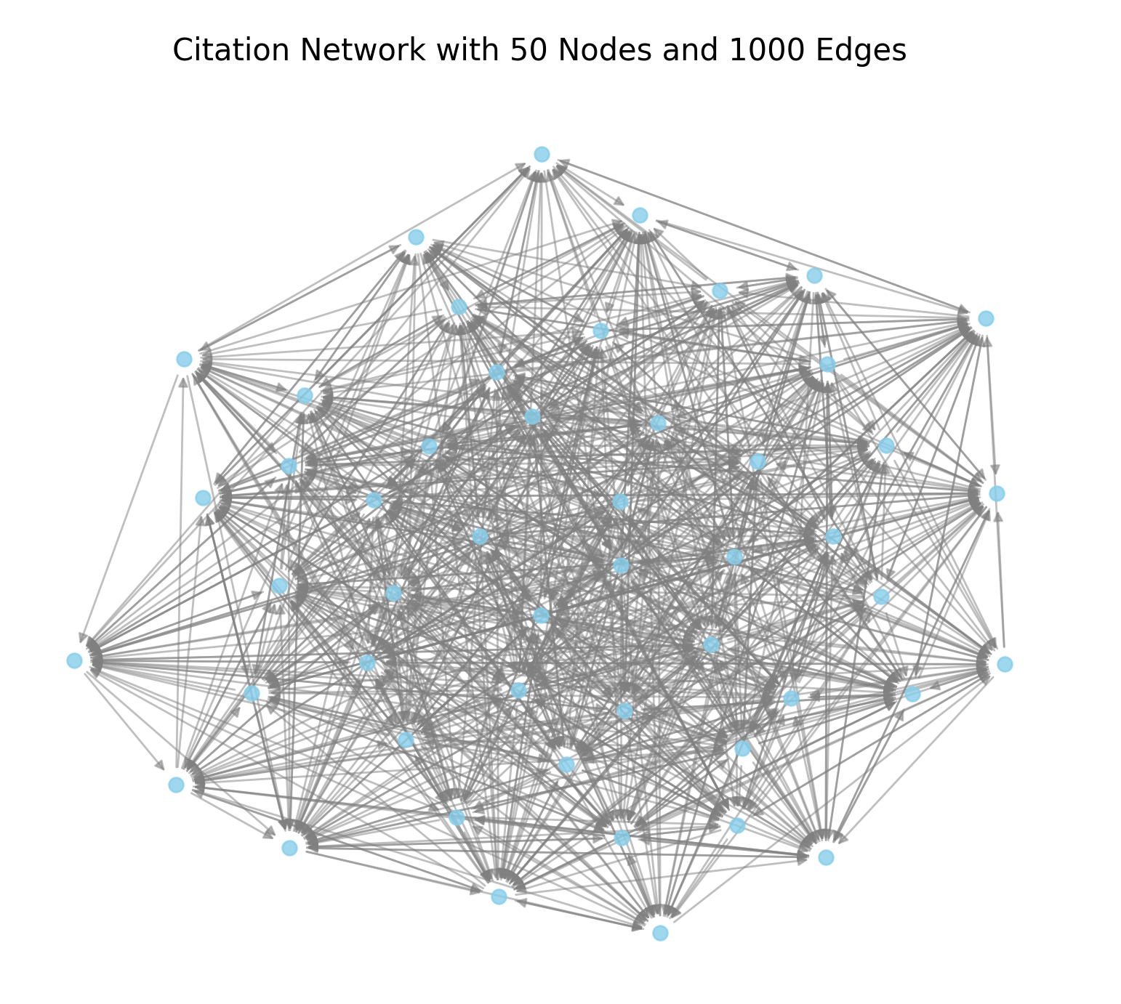
Citation
Network
What is Citation?

Slide 4

INTRODUCTION
Citation analysis is a method to measure the impact or quality of an author, article, or publication by counting how many times it has been cited by other works.
Analyzing legal systems
Identifying important papers
Explaining academic promotions

Slide 5

RELEVANCE
01
Identifying Key Influencers
02
Tracking Knowledge Flow
03
Measuring Research Impact
04
Detecting Research Gaps
05
Collaboration Patterns

Slide 6
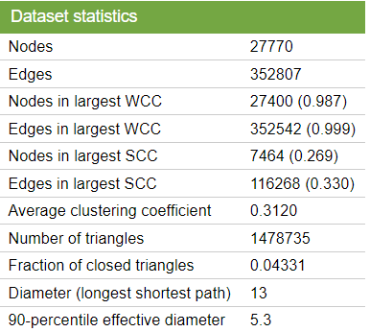
ABOUT DATA SET
SOURCE
J. Leskovec, J. Kleinberg and C. Faloutsos. Graphs over Time: Densification Laws, Shrinking Diameters and Possible Explanations. ACM SIGKDD International Conference on Knowledge Discovery and Data Mining (KDD), 2005.
J. Gehrke, P. Ginsparg, J. M. Kleinberg. Overview of the 2003 KDD Cup. SIGKDD Explorations 5(2): 149-151, 2003.

Slide 7



WHAT WE HAVE DONE?
Local Clustering Cofficient
01
Global Clustering Coefficient
02
Eigen Vector Centrality
03
Katz Centrality
04
Closeness Centrality
05

Slide 8

CONTINUE...
Hub & Authority
06
Page Rank Centrality
07
Assortativity
08
Reciprocity
09

Slide 9
IN CONTEXT OF LOCAL CLUSTERING COEFFICIENT
IN CONTEXT OF GLOBAL CLUSTERING COEFFICIENT
Measure of Local Influence
Research Specialization
Knowledge Circulation
Identification of Research Hubs
Measure of Overall Network Connectivity
Indicator of Scholarly Community Structure
Insight into Network's Density
Reflects Cross-Citation Patterns
Research Domain Cohesiveness
IN CONTEXT OF EIGEN VECTOR CENTRALITY
IN CONTEXT OF KATZ CENTRALITY
Measure of Influence in the Network
Identification of Key Papers or Authors
Importance Based on Connections to Influential Nodes
Indicator of Knowledge Flow
Measure of Influence within the Network
Accounts for Indirect Citations
Weighted Path Importance
Recognition of Long-Range Connections

Slide 10
IN CONTEXT OF CLOSENESS CENTRALITY
IN CONTEXT OF PAGE RANK CENTRALITY
Measure of Influence
Proximity to Other Papers
Information Spread Efficiency
Indicator of Research Accessibility
Measure of Influence
Identifies Key Papers or Authors
Ranks Importance in Citation Flow
Detects Authoritative Sources
IN CONTEXT OF HUB & AUTHORITY
IN CONTEXT OF ASSORTATIVITY
Hub: Identifies Papers with Strong Outgoing Links
Authority: Recognizes Highly Cited Papers
Hub: Source of Information or Citations
Authority: Central Source of Knowledge
Collaboration PatternsNetwork Structure:
Field of Research Homogeneity
Author Impact
Similarity of Nodes

Slide 11
Coding Section……..

Slide 12
ANY SUGGESTIONS?

